Slide 1


LANL Team Update
11/20/2024
Izzy Baumler, Dalton Boeckmann, Morgan Gullo, Jade Waldron

Slide 2
Mission Statement
There is a need for a technology that has 6 DOF and can move through its full range of motion in each degree of freedom of at least 1 Hz.

Slide 3
Weekly Updates
All members have finished Yellow Badge Training for 3D-printer access and is scheduled for training next week
Confirmed space for MEEN 402 in the FEDC for next semester
Meeting with sponsor went well last friday and approves of our progress
Continued working on Embodiment Design and Validation Plan

Slide 4
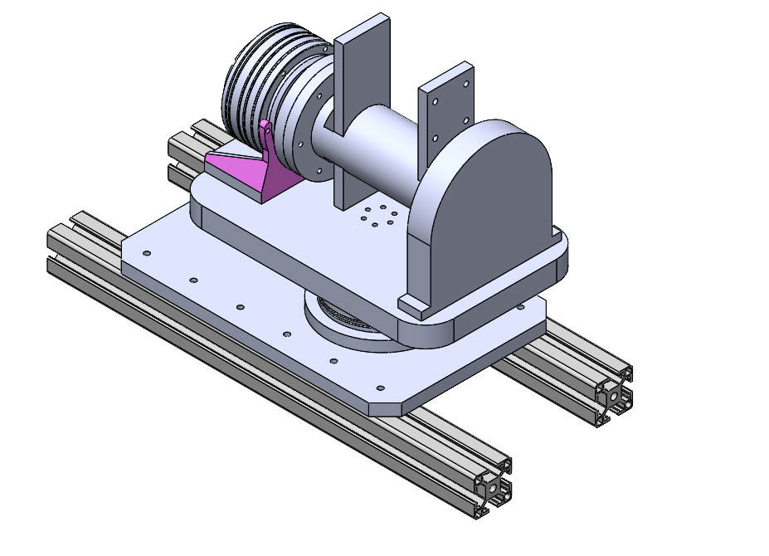
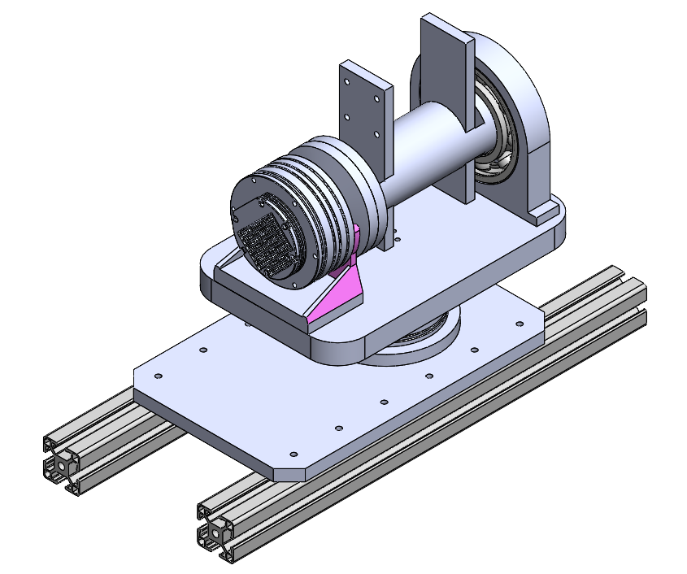
Detailed CAD - Joint 1 & 2 Trial 1

Slide 5
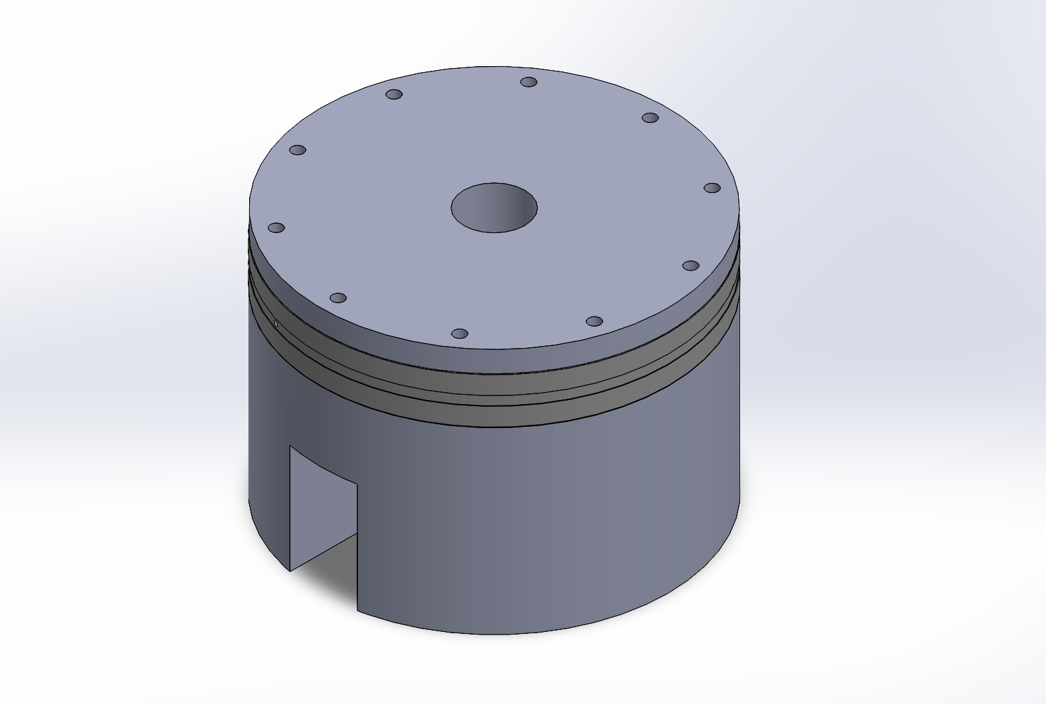
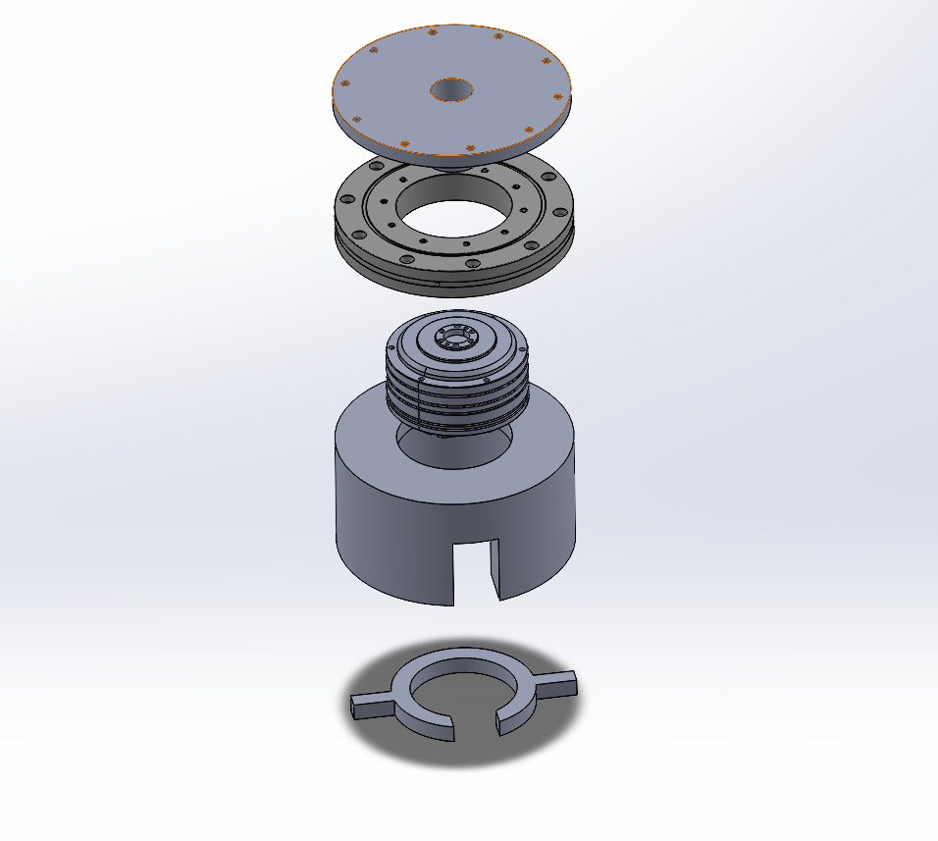
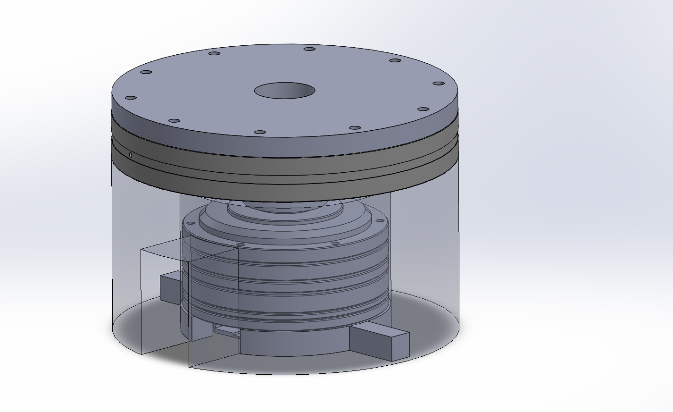
Detailed CAD - Joint 1 Trial Two

Slide 6
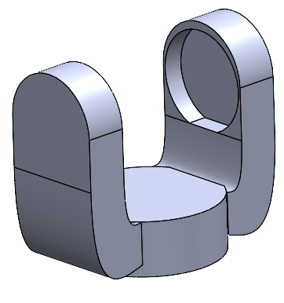
Detailed CAD - Joint 2 Holder

Slide 7
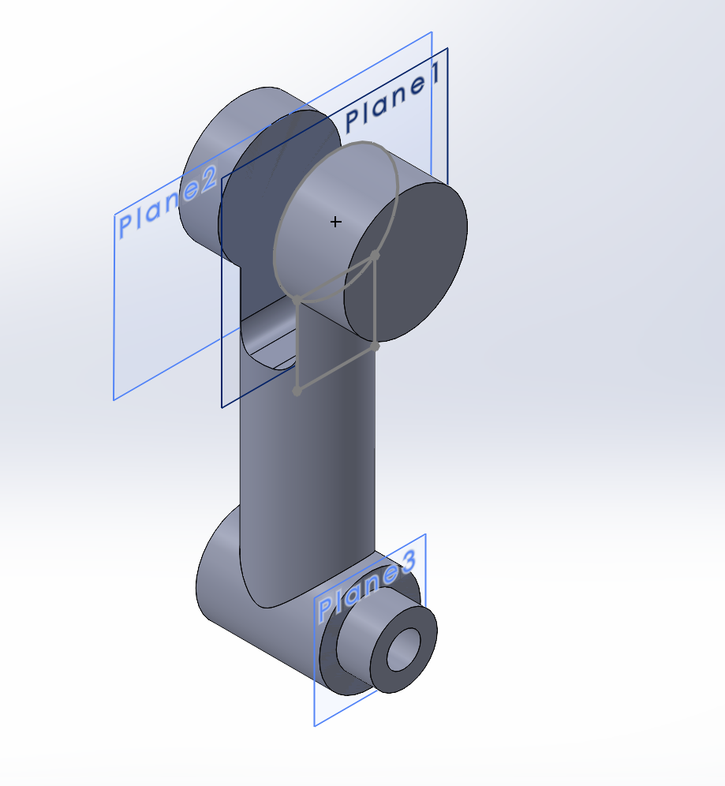
Detailed CAD - Joint 2 Linkage

Slide 8
Validation Plan
Finite Element Analysis (FEA) to see the amount of payload the arm can support without straining or seizing the motors
Inspect all joints to ensure they are free from any obstructing components
Implement initial codes for small translational/rotational movements to validate the motor inputs correspond with the output performance
Validate each motor one at a time before trying to perform movements with multiple at once
Verify each joint speed to confirm the achieved frequency
Calculate the total arm weight and confirm with scale measurement

Slide 9
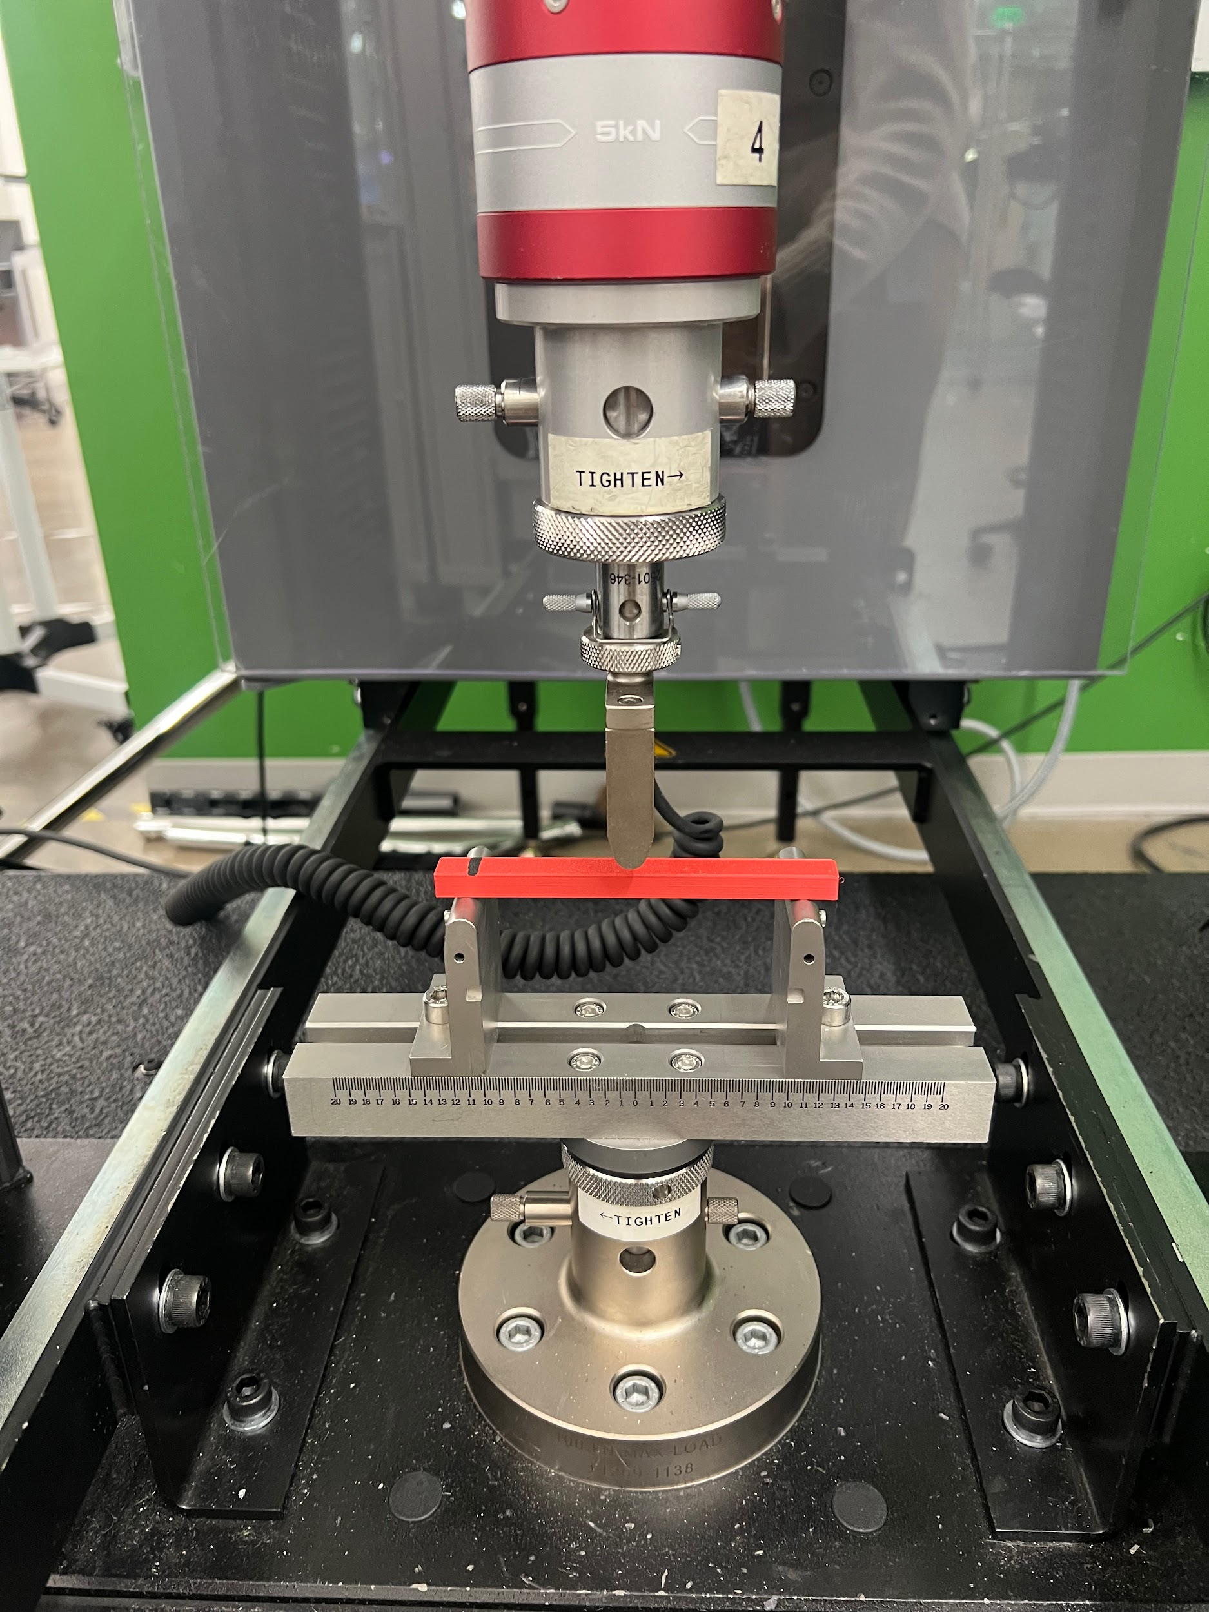
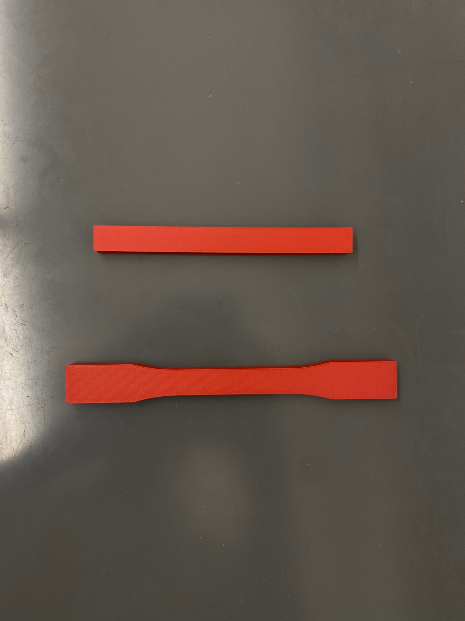
Material Testing: 3 Point Test
Performed 3 point bending test in order to calculate the Flexural Strength and the Flexural Modulus
Flexural Stress: the maximum stress a material can withstand before breaking
Flexural Strain: the fractional change in the length of a material's outer surface when it's under flexural stress
Flexural Modulus: measures the material's stiffness or resistance to bending

Slide 10
Material Testing: 3 Point Test
Experimental Procedure:
Measured the PLA sample with calipers
Set support span to 108 mm
Cross head rate 0.005 mm/min

Slide 11
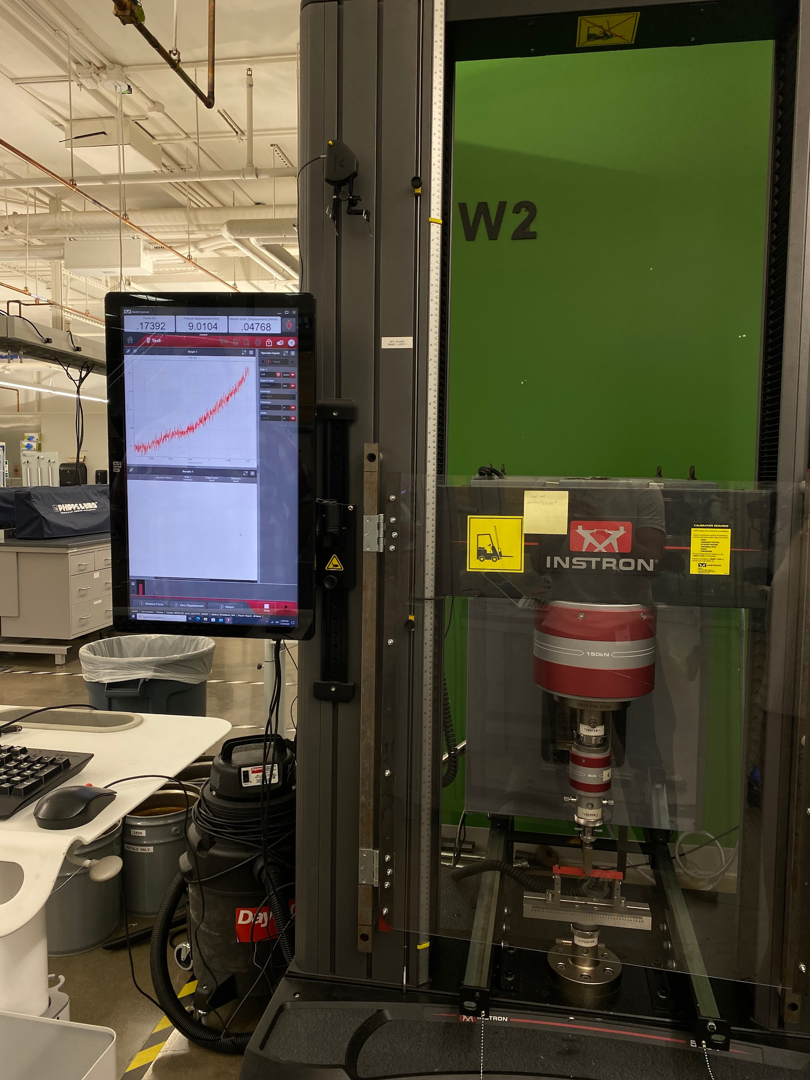
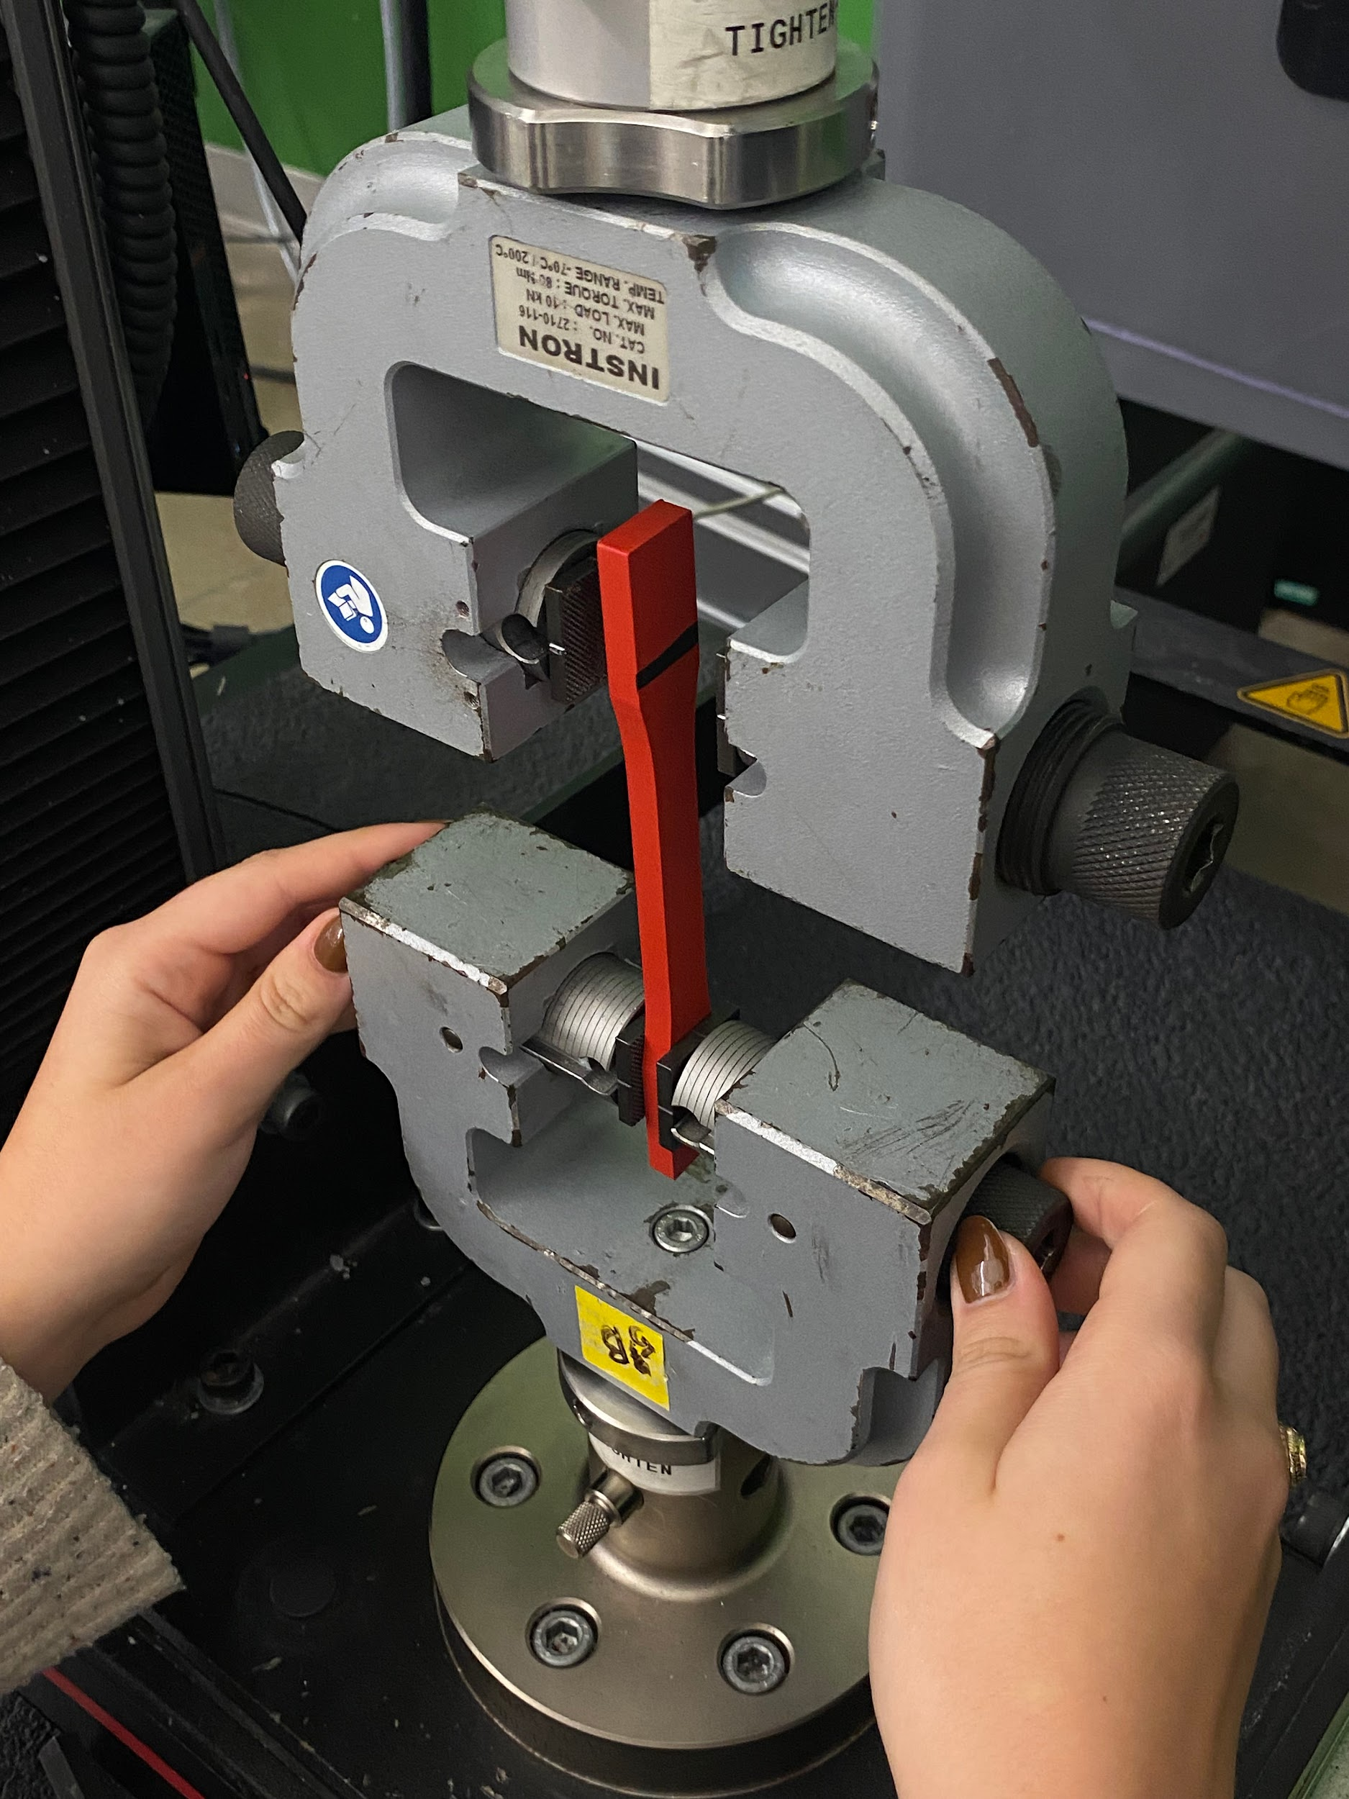
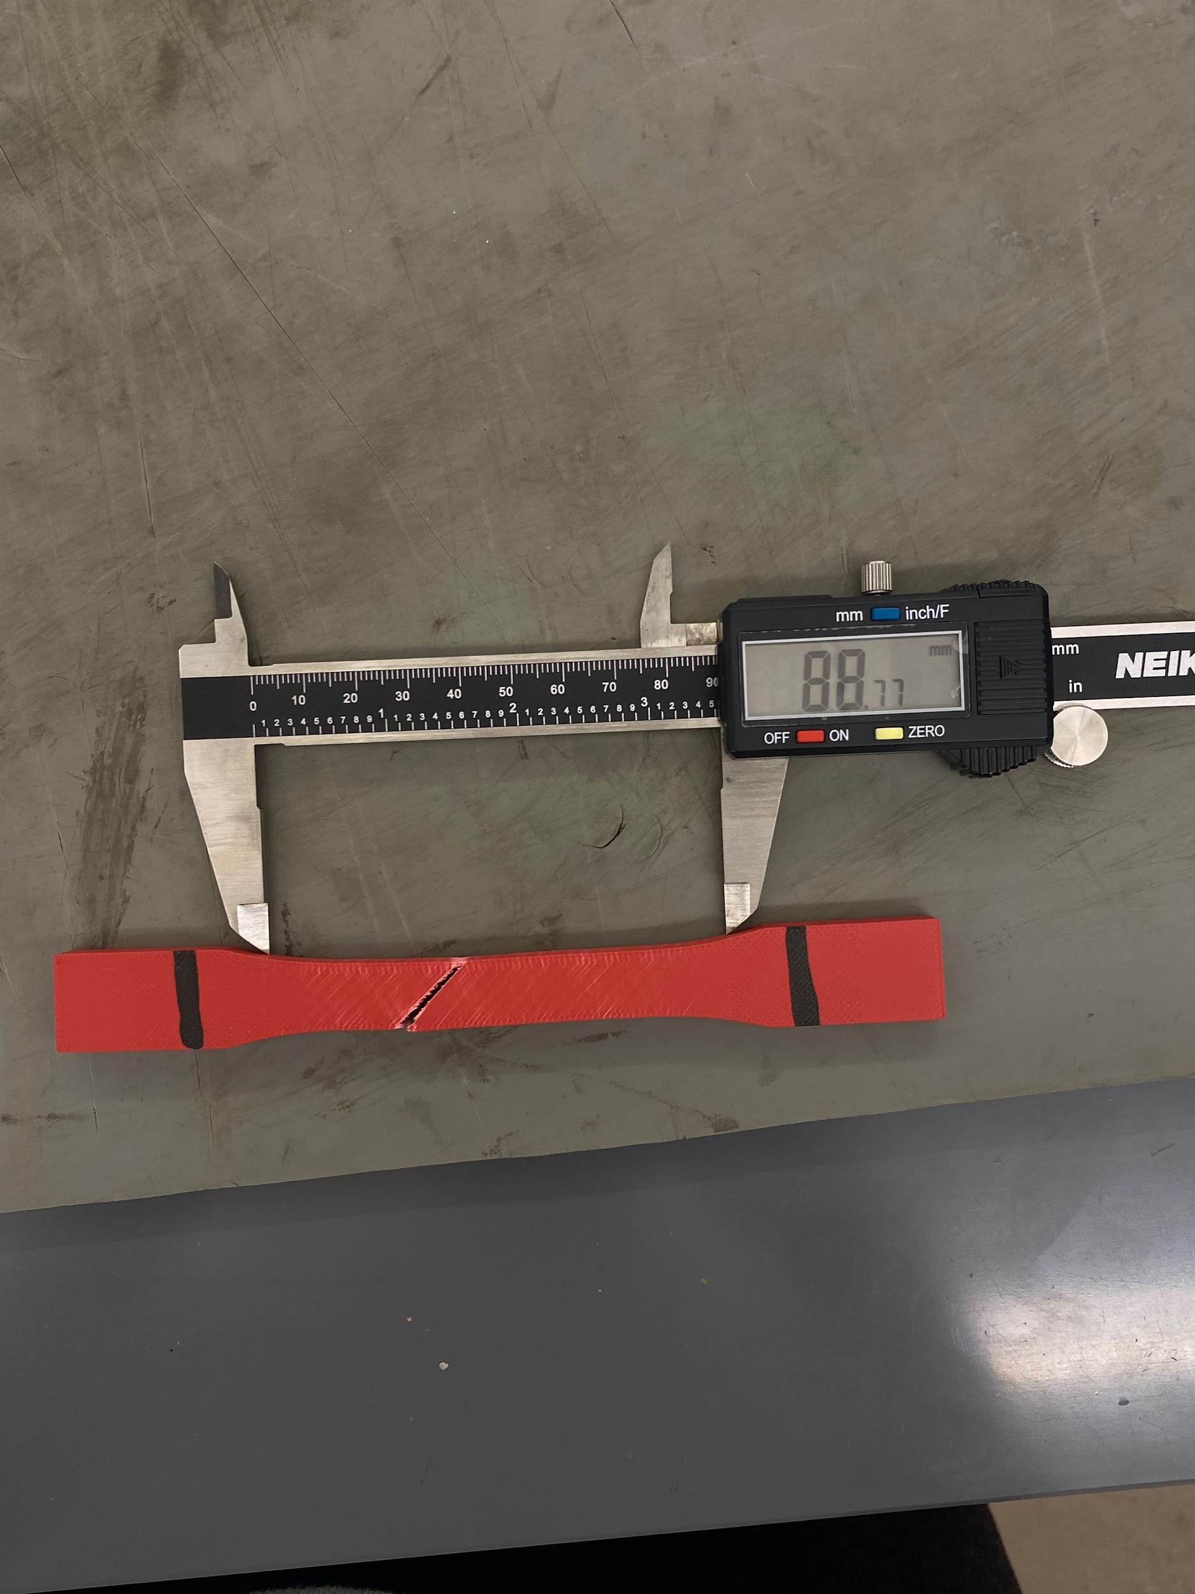
Material Testing: Tensile Test
Experimental Procedure:
Measured the PLA sample with calipers
Set grips at 25 mm from each end of the sample
Set test speed to 5 mm/min
Measured elongation of sample after plastic deformation was reached

Slide 12
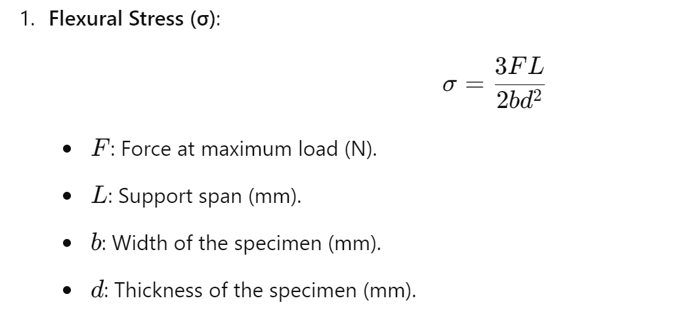
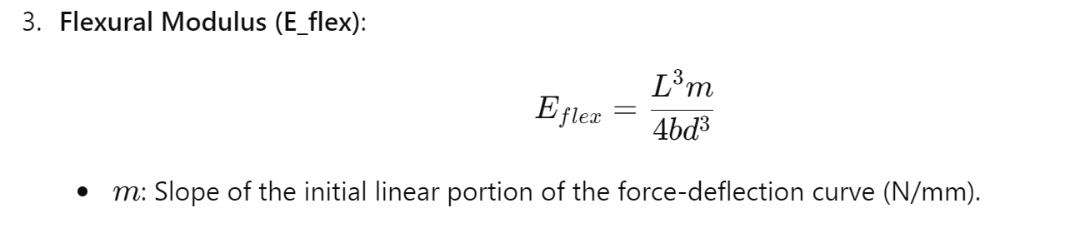
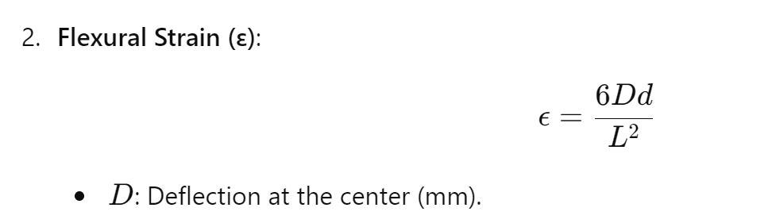
Calculations

Slide 13
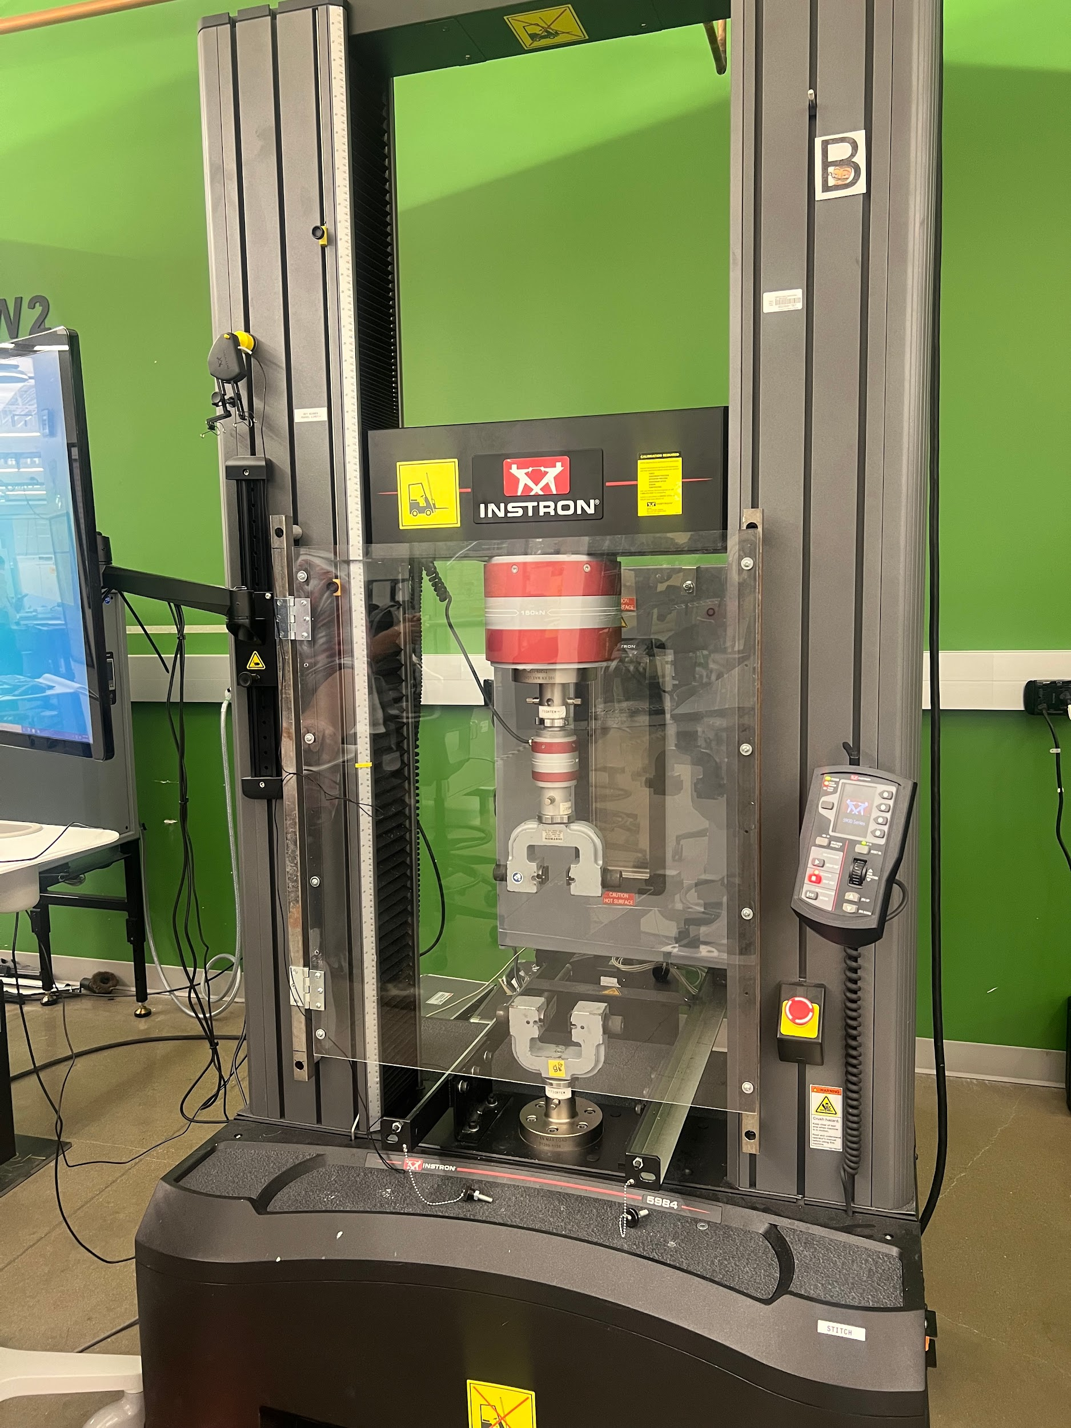
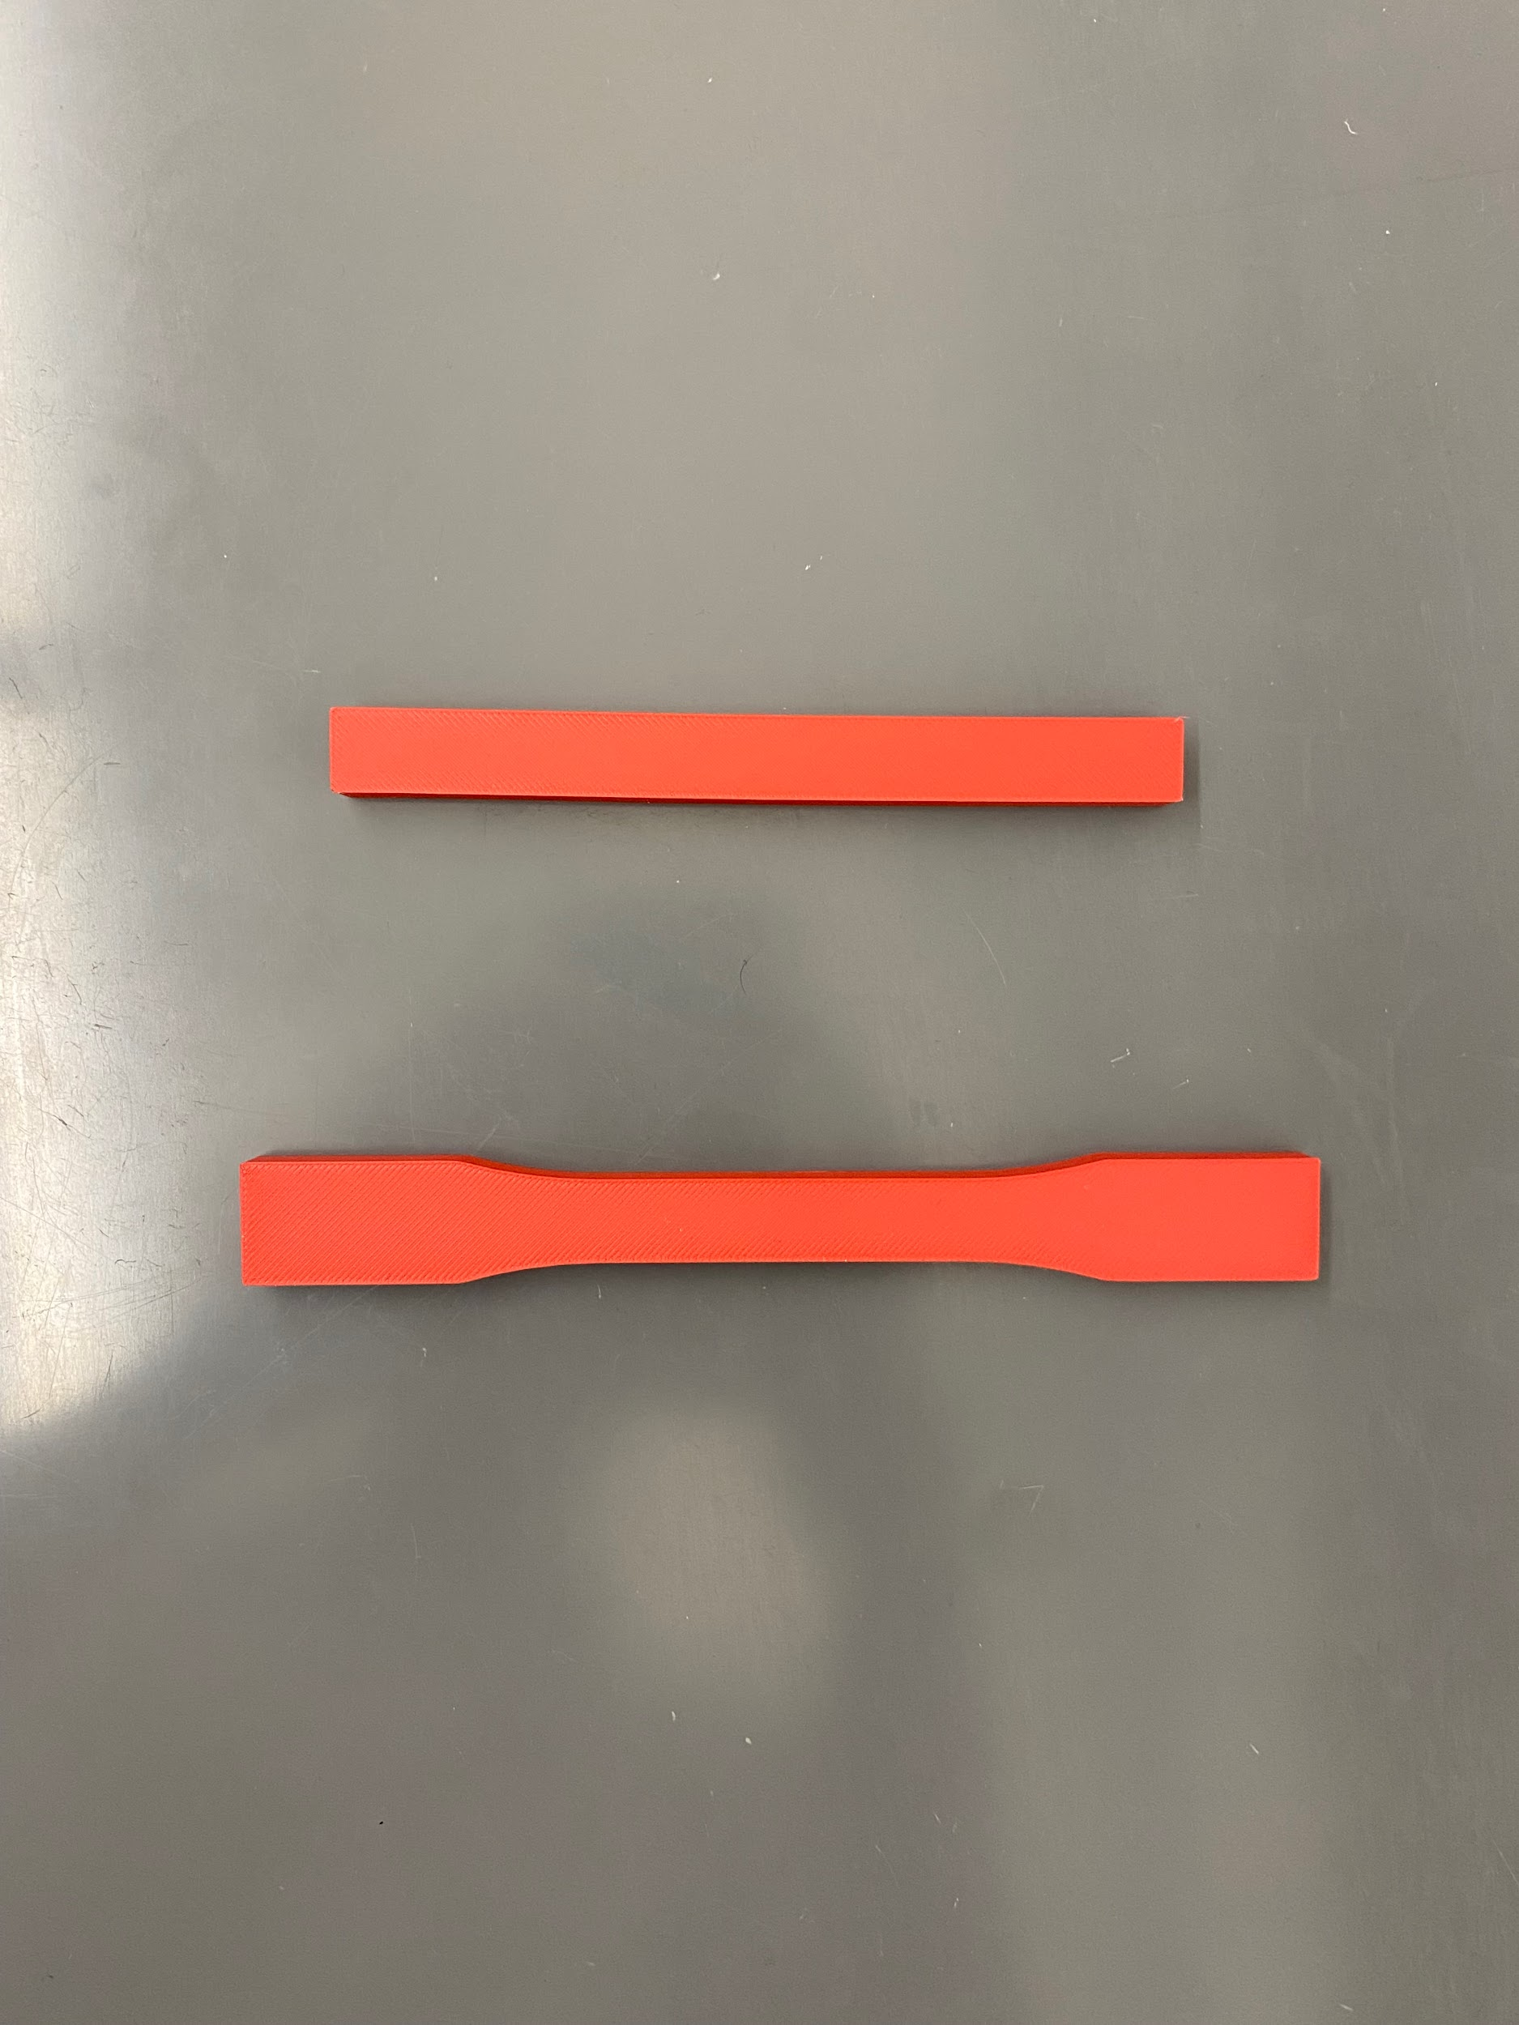
Material Testing: Tensile Test
Performed tensile test in order to calculate the Elastic modulus, mass density, tensile strength, and yield strength

Slide 14
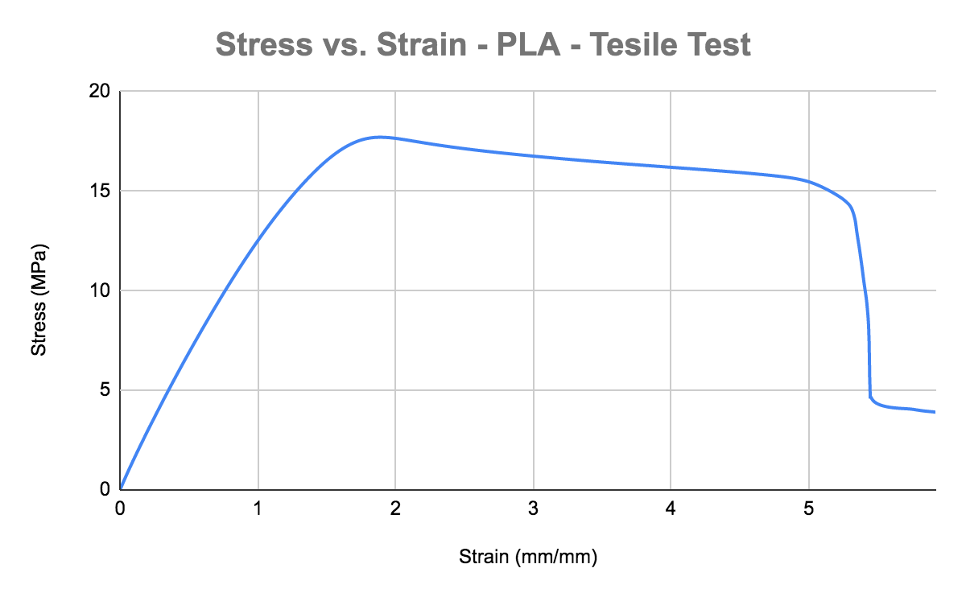
Material Testing: Tensile Test Results
Yield point
Elastic Modulus | 11 | MPa
Mass Density | 773.3248667 | kg/m^3
Tensile Strength | 11426304.65 | N/m^2
Yield Strength | 14.8 | MPa

Slide 15
Upcoming Week
Meeting with Research Assistants at the Robotics and Automation Design (RAD) Lab on Friday at Rellis Lab
Continue working on detailed CAD Model
Final Presentation Scheduled November 25th at 3:05 PM in ZACH 256
Receive Yellow Badge Access
Begin ordering materials for arm
Continue working on DR3 materials
Update BOM to reflect fastener changes

